Slide 1
Analytics FOR BUSINESS Intelligence
Fall 2021
Nuria Diaz-Tena
Notes:
Attendance and Seating

Slide 2
To Review:
Normal Distributions
T Distributions
Types of comparisons
One sample
Two samples
Equal number of observations and standard error
Unequal number of observations
Unequal variances
Statistical Experiment Review
Regression Analysis

Slide 3
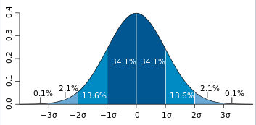
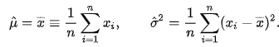
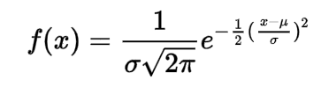
Normal Distribution
The parameter mu is the mean, and the parameter sigma is its standard deviation.

Slide 4
Z and T Distribution
R using ttest
Excel

Slide 5
Sampling Learning Objectives
Understand differences between populations and samples
Understand how samples can go wrong
Understand how bias is defined
Identify potential sources of bias in a sample
Understand how to best obtain random samples
Understand there is variability in samples and how it’s affected by a sample’s attributes
Estimate margins of error and confidence intervals
Identify sampling frames and how they might differ from populations
Identify potential sources of bias that can occur even in well-designed studies and how they can be managed

Slide 6
Errors in Sampling
Sampling errors are errors caused by the act of taking a sample. They cause sample results to be different from the results of a census.
Nonsampling errors are errors not related to the act of selecting a sample from the population. They can be present even in a census.

Slide 7
1. Sampling Errors
A. Random Sampling Error
Deviation between the statistic and parameter
Caused by chance in selecting a random sample
ONLY error accounted for in the margin of error in a confidence statement
B. Bad Sampling Methods
Convenience and voluntary response samples
An incomplete sampling frame can cause undercoverage, where certain groups of the population are left out.

Slide 8
2. Nonsampling Errors
A. Processing Errors
Mistakes in mechanical tasks such as arithmetic or data entry
B. Poorly Worded Questions
Question is slanted to favor one response over the other
C. Response Error
Response from an individual in the survey that is inaccurate from lying, bad memory, etc.
D. Nonresponse Error
Failure to obtain data from an individual selected for a sample

Slide 9
Stratified Random Sampling
Step 1: Divide the sampling frame into
distinct groups of individuals, called strata.
Choose strata because you have an interest in the groups or because the individuals within each group are similar.
Step 2: Take a separate SRS in each stratum and combine these to make up the complete sample.

Slide 10
The Challenge of Internet Surveys
Using the Internet for “Web surveys” is becoming
increasingly popular.
Advantages:
Easy to collect large amounts of data
Costs less money
Allows for delivery of multimedia content
Disadvantages:
Not easy to do well
Voluntary response, undercoverage, nonresponse

Slide 11
Collecting Data from Open Source conversations
There is already lots of opinions about lots of topics on twitter, blogs, etc.
Can we use this data to gather information?

Slide 12
Course Planning
Lecture | Date | Topic | Assignments | Wg
1 | 9/01/21 | Introduction, Visualizations & Exploratory Data Analysis - Chapter 1
2 | 9/15/21 | Introduction to R
3 | 9/22/21 | Statistical Experiments | Homework #1 | 5%
4 | 9/29/21 | Regression – Chapter 2 and 3 | Homework #2 | 5%
5 | 10/06/21 | Bayesian Models
6 | 10/13/21 | Models Review | Project #1 | 15%
 | 10/20/21 | Midterm Exam | Midterm | 20%
7 | 10/27/21 | Classification Models – Chapter 4
8 | 11/03/21 | Cross Validation and Advance Classification – Chapter 5 to 9 | Homework #3 | 5%
9 | 11/10/21 | Advance Classification | Homework #4 | 5%
10 | 11/17/21 | Support Vector Machines - Chapter 9
 |  | Thanksgiving Recess
 | 11/29/21 | Review of Machine Learning Models
11 | 12/01/21 | Clustering - Chapter 10
12 | 12/06/21 | Project Discussion
13 | 12/08/21 | Final Exam Preparation | Project #2 | 15%
 | 12/22/21 | Final Exam | Final | 30%

Slide 13
Project:
Project # 1
Life expectancy
1. What is the best model to predict life expectancy with the data provided in the following two links?
https://www.worldometers.info/demographics/life-expectancy/#countries-ranked-by-life-expectancy
https://www.worldometers.info/world-population/population-by-country/
2. Which other variables could you include in the model to improve predictions of life expectancy?
Median Value of Own houses in Boston area
What I the best model to predict the median value of the houses in the Boston area?

Slide 14
What is a Statistical Model?
input variables
independent variables
feature variables
Predictors
Drivers
output variable
response
dependent variable
Error Term
Y =f(X)+ε actual
ˆ Ŷ= f(X) predicted
ˆ
E(Ŷ −Y)² = [f(X)−f(X)]² + Var(ε)
Which predictors are associated with the response?
What is the relationship between the response and each predictor?
Can the relationship between Y and each predictor be adequately summarized using a linear equation, or is the relationship more complicated?
Simple Model – Linear Regression
Y = a + b*(X)+ε actual

Slide 15
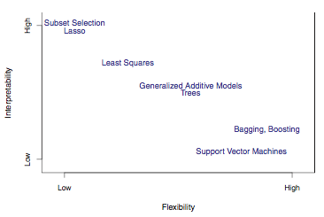
Types of Models
Model Form
Response Type
Parametric Model
f(X) = β0 +β1X1 +β2X2 +...+βpXp linear model
Regression Model
Numerical Response
Linear Regression
K-Nearest Neighbor
Boosting
Classification Model
Categorical Response
Logistic Regression
K-Nearest Neighbor
Boosting
Non-Parametric Model
f(X) = any model form of x flexible model

Slide 16
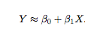
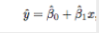
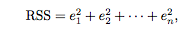
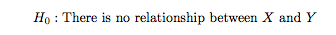
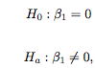
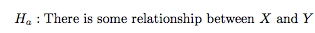
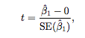
Linear Regression
Estimate Intercept and slope by minimizing the
Residual Sum of Squares (RSS)
All formulas in Chapter 3.
Y =f(X)+ε actual +ε
ˆ Ŷ= f(X) predicted
P-value –
the probability of observing any number equal to |t| or larger in absolute value, assuming β₁ ^{= 0.}

Slide 17
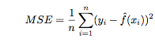
Error Discussion
Differences and relationships between:
RSS –Residual Sum of Squares
MSE - Mean Square Error
RSE - Residual Standards Error = sqrt(RSS/(n − 2))
R-Square = 1- TSS/RSS
Adjusted R-Square
AIC
MAPE – “Mean Absolute Percent Error”
Correlation
AIC = n log(Var) +2K
K- number of predictors
* TSS : Total Sum Squares ( Sum of square difference between y and mean(y))

Slide 18
Model Diagnostics, Significance and Fit
Check Residual plot:
Are the residuals around 0 with no pattern?
If not, there may be a better form instead of linear
Are the residuals of equal value in all independent values?
If not, the residuals have heteroscedasticity instead of homoscedasticity and it is suggested to use logs.
Outliers.
Check for outliers on the residual plot. Do this outliers affect the predictions?
High-leverage points. Very influential points
Check the leverage versus residual plot
Collinearity
Check correlations to know the best predictors for he model
Are the p-values less than 5%?

Slide 19
Multiple Linear Regression
input variables
independent variables
feature variables
Predictors
output variable
response
dependent variable
Error Term
Reducing error term
Reducible error
Irreducible error
Variance
Y =f(X)+ε actual Y = B₀ +B₁*X₁+B₂*X₂+…+B_{n}*X_{n} +Error
More than One Driver
Which predictors are associated with the response?
What is the relationship between the response and each predictor?
Can the relationship between Y and each predictor be adequately summarized using a linear equation, or is the relationship more complicated?
R using for linear regression

Slide 20
Model Accuracy on Testing Set or Hold-out period
The Model is estimated on the Training Set (80%)
The Model is evaluated on the Testing Set (20%)or Hold-Out Period (Time Series data – most recent Period)
Regression - Mean Square Error
Classifier – Accuracy

Slide 21
To Do:
Project # 1
Read Chapter 3

